Slide 1
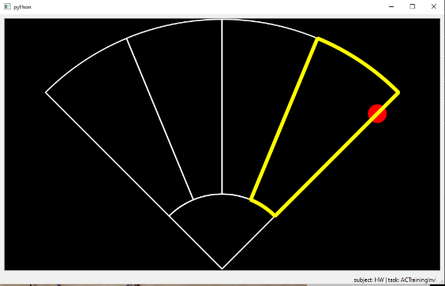
Computer training
Task 1: Training with visible feedback 1. 2-minute free training 2. Tests
Task 2: Training without visible feedback 1. 2-minute free training 2. Tests
During the test, you will need to hit the highlighted target as fast as you can. You will finish the training task if you pass two test blocks successively. Otherwise, you need to take another 2-minute free training and then test again.

Slide 2
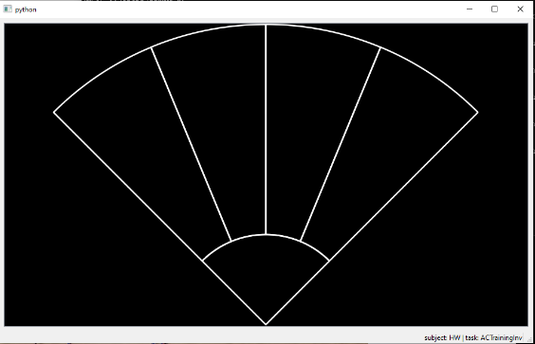
Control mapping (abstract control)
Move the Cursor from “Rest” to a target to make a grasp with the corresponding grip.
If the prosthetic hand is not open when receiving a new grasp command, it will open the hand first before making the new grasp.
The dwell time of this system is 240ms, participants need to hold the cursor within a target for 240ms to make a grasp.
The time of response should below 500ms. If the hand does not response after participants contract their muscles for a while, it is possible that the hand does not receive the command (e.g. the cursor does not return to “Rest” for 240ms before moving to a new target). Participants are suggested to relax both muscles for a while and then try to grasp again.
Tripod Grip
Point Grip
Power Grip
Hand Open
Rest

Slide 3
Control mapping (direct control)
Move the Cursor from “Rest” to “Hand Close” to make a grasp with the selected grip and to “Hand Open” to open the hand.
Move the Cursor from “Rest” to “Switch Grip” (middle two targets) to switch the selected grip.
Grip order: Power Grip -> Tripod Grip -> Point grip->(back to power grip).
When “Hand Close” command is received if the hand is already close, the prosthetic hand will open and then make a grasp again.
Hand Close
Switch Grip
Hand Open
Rest

Slide 4
Control mapping (direct control)
The dwell time of this system is 240ms, participants need to hold the cursor within a target for 240ms to make a grasp (the two middle targets are considered as the same target in direct control).
The time of response should below 500ms. If the hand does not response after participants contract their muscles for a while, it is possible that the hand does not receive the command (e.g. the cursor does not return to “Rest” for 240ms before moving to a new target). Participants are suggested to relax both muscles for a while and then try to grasp again.
Hand Close
Switch Grip
Hand Open
Rest

Slide 5
Box and blocks test instruction
Aim: To pick up the blocks with your prosthetic hand using POWER grip and carry it to the other side of the box as fast as possible within 60 seconds.
Place your hands on the sides of the box. When it is time to start, I will say ready and then go.
If you pick up two blocks at a time, they will count as one, so do not waste time picking it up.
If you pick up the block using TRIPOD grip, it will not be counted, so you need to drop it down and pick it up with POWER grip again.
Before the test, there will be a 60-second trial, where we will show the MCI to you as visual feedback. During the test, the MCI is unavailable. There will be 10 trials in the test (5 PC power + 5 battery power).
If you find that the prosthetic hand does not respond after contracting the muscle, it is likely that the cursor doesn’t go back to the rest state before it moves to a new target. Remember that we have a 240ms dwell time in this system, so please do not make a grasp faster than that. Please relax your muscles for a while before making a new grasp. If this situation continues, it may be due to muscle fatigue and please relax your muscles for a longer period before making a new grasp and ask for a break after this trial.
Notes:
https://www.physio-pedia.com/Box_and_Block_Test

Slide 6
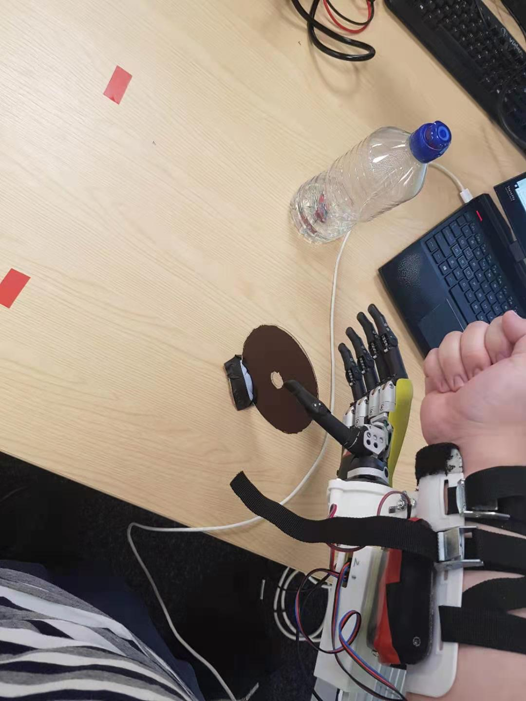
Pick and place test instruction
Aim: Start a trial by clicking the ENTER on the keyboard, move the objects from right to left, and end the trial by clicking SPACE on the keyboard.
Requirement: Finish the activities with selected grip:
Pick up the can: power grip
Pick up the CD: tripod grip
Press keyboard: point grip

Slide 7
Pick and place test instruction
Task 1: 1. Click ENTER with point grip 2. Relocate the can from right to left with power grip 3. Relocate the CD from right to left with tripod grip 4. Click SPACE with point grip
Task 2: 1. Click ENTER with point grip 2. Relocate the CD from right to left with tripod grip 3. Relocate the can from right to left with power grip 4. Click SPACE with point grip
You will hear a beep when clicking the ENTER or SPACE keys on the keyboard.
Please try NOT to touch the WIN key as it may stop axopy from receiving keyboard activities.

Slide 8
Pick and place test instruction
Training 1. Practise task 1 until you can finish the task without error (object drops, using wrong grip for an activity, or the hand prosthesis fail to response to your muscle contraction) twice successively. 2. Practise task 2 until you can finish the task without error twice successively.
Test 1: Finish task 1 without error 5 times (in total)
Test 2: Finish task 2 without error 5 times (in total)

